Slide 2
Our selection criteria
┋ All calls open to researchers based in France
… but most of them open to other national research communities as well, e.g. German ☺
┋ Mobility and project funding, no travel or conference grants (long stays > 1 month)
┋ Social sciences and humanities only
… even though many non-thematic calls
┋ Post-PhD only
… even though some also have a doctoral component or no degree discrimination at all

Slide 5
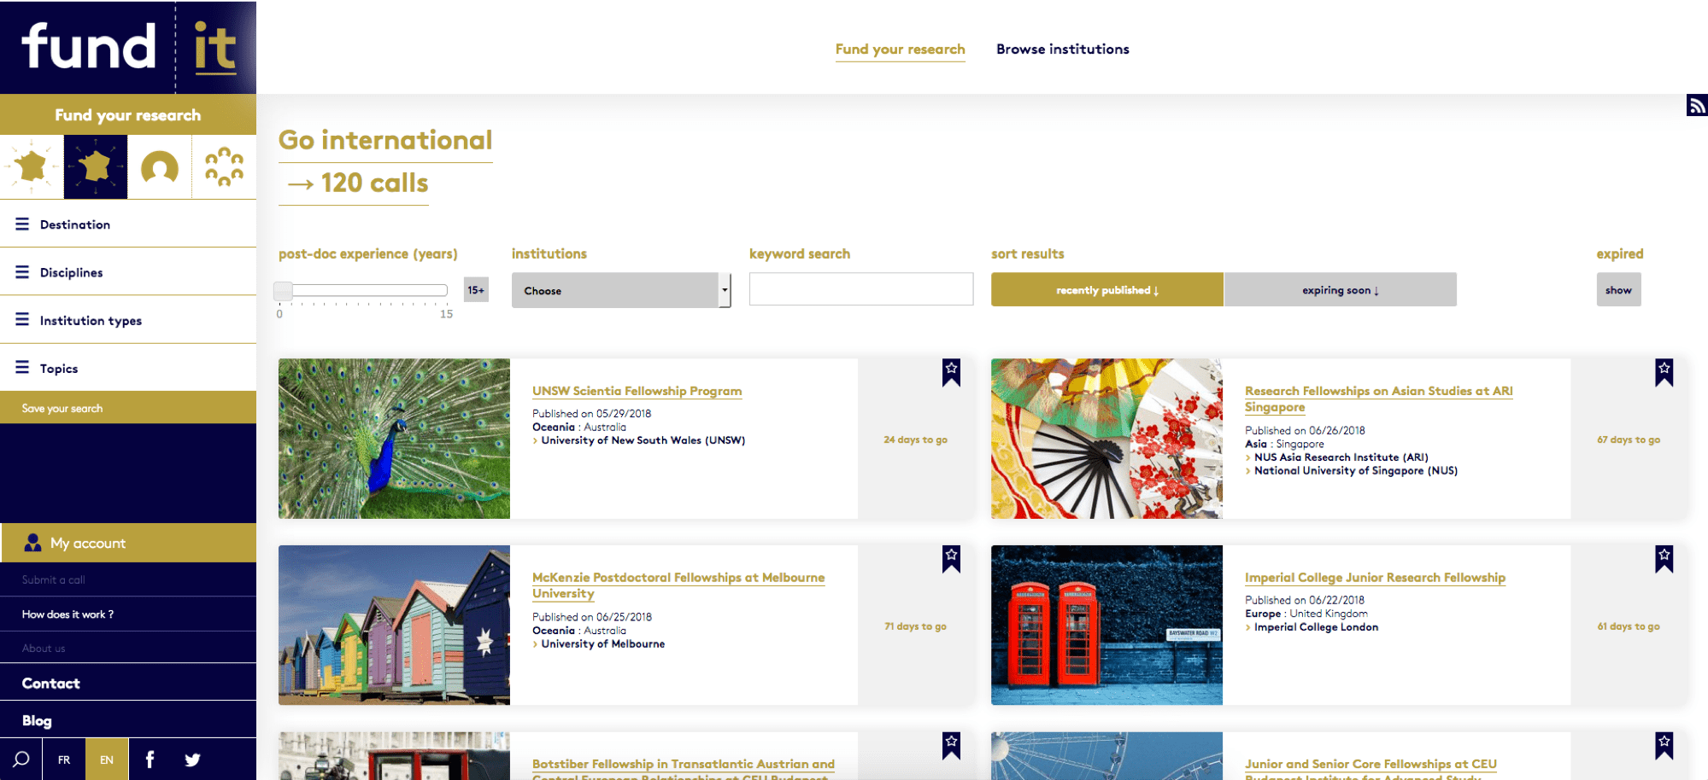

Slide 7
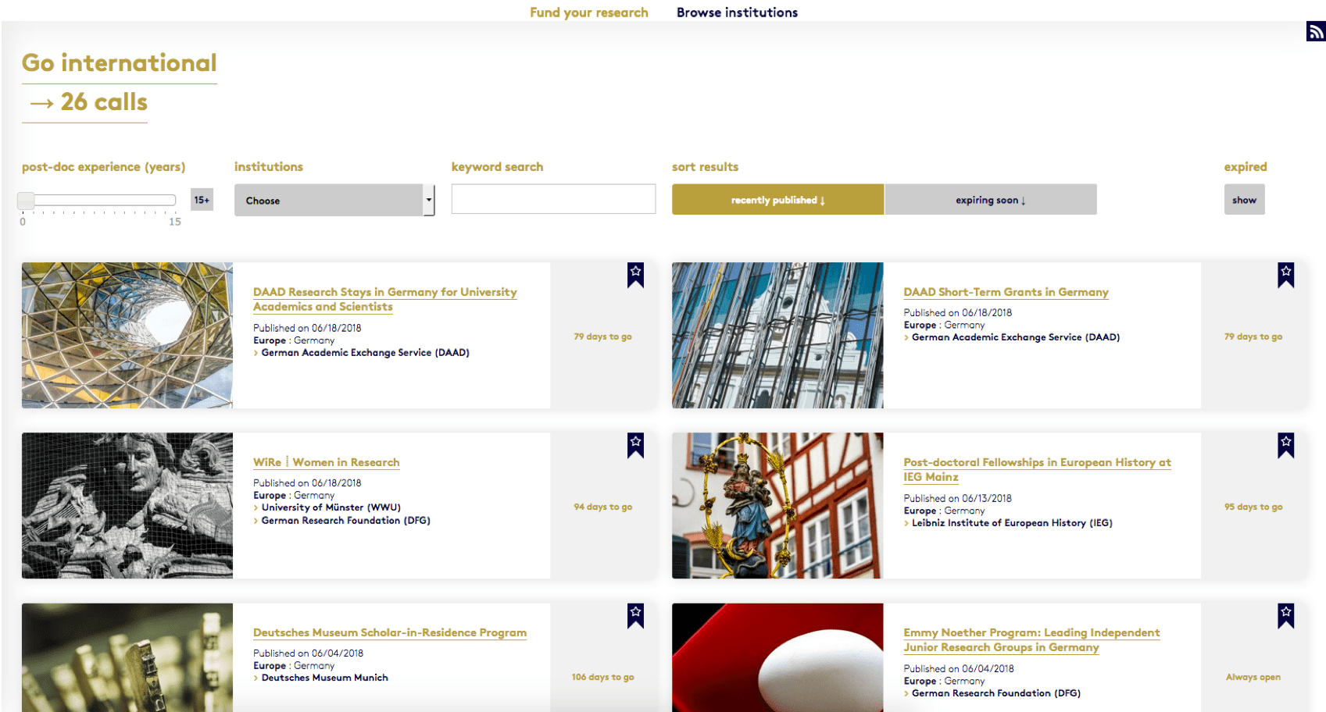

Slide 9
Notes:
Universitäten…

Slide 10
Notes:
Universitäten…

Slide 11
Notes:
Stiftungen…

Slide 12
Notes:
Stiftungen….

Slide 13
Notes:
Museen und Bibliotheken

Slide 14
Notes:
Museen und Bibliotheken

Slide 15
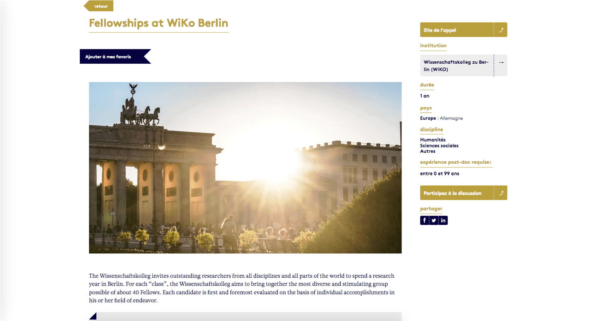
Notes:
Institutes of Advanced Study

Slide 16
Notes:
Institutes of Advanced Study

Slide 24
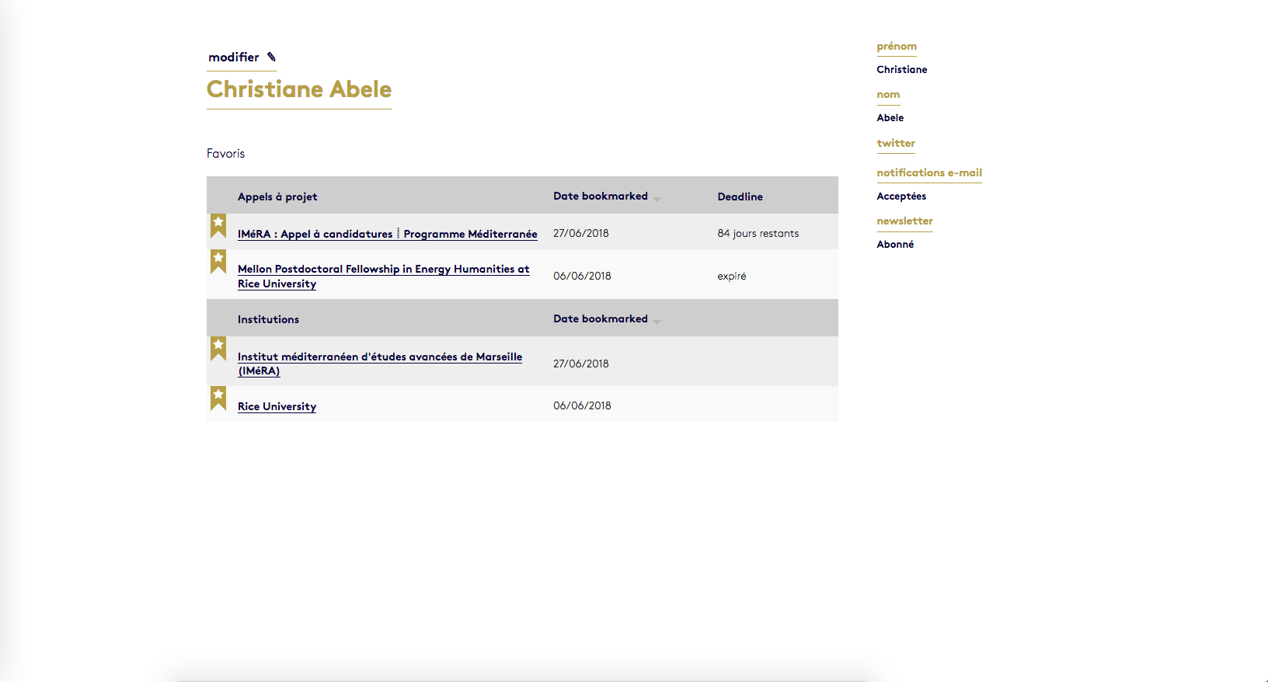
Notes:
LabEx

Slide 25
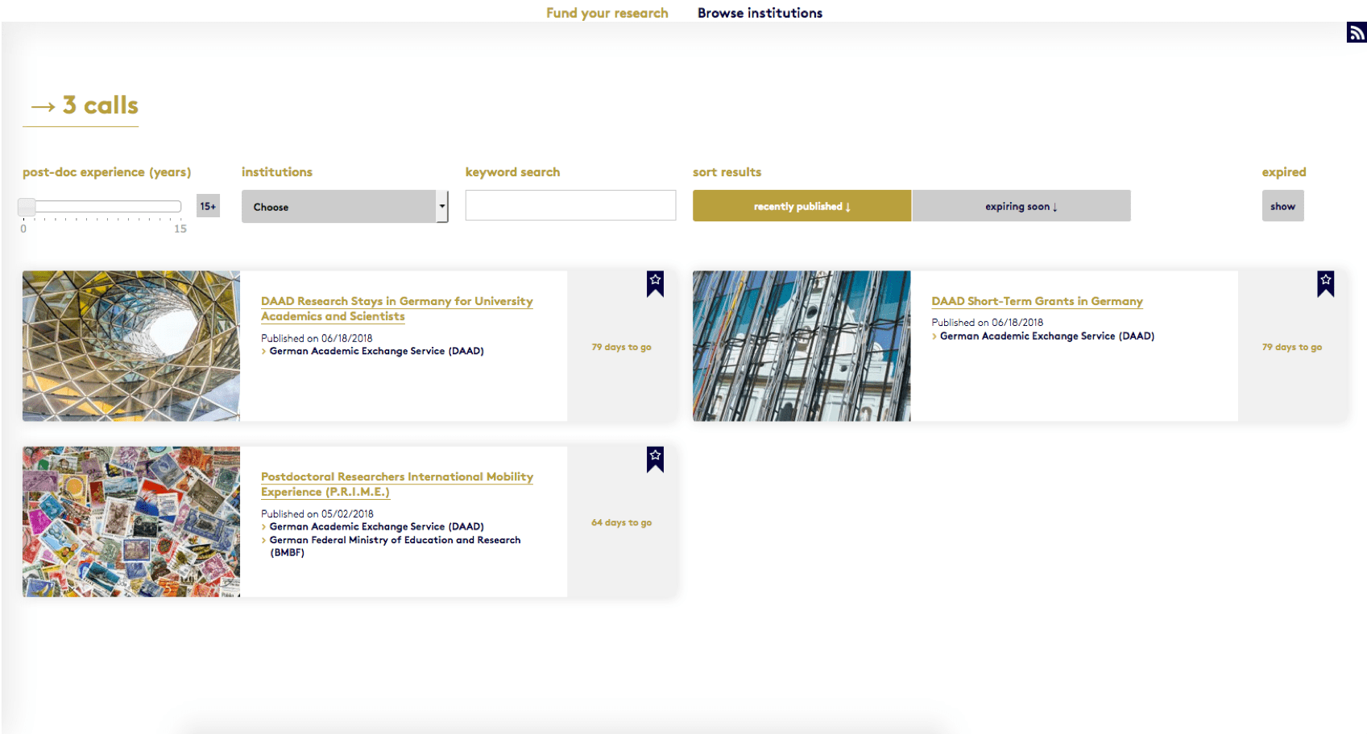
Notes:
DAAD

Slide 26
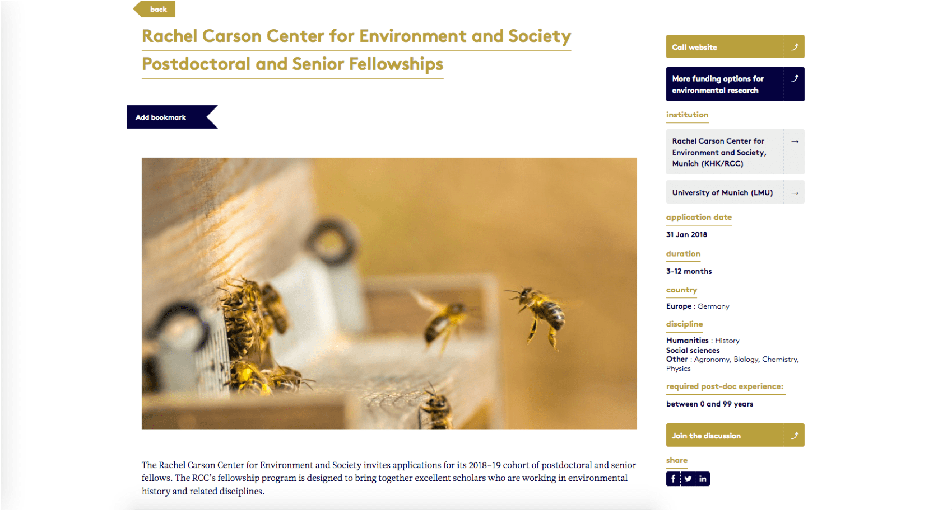
Notes:
KHK

Slide 27
Notes:
MPI

Slide 28
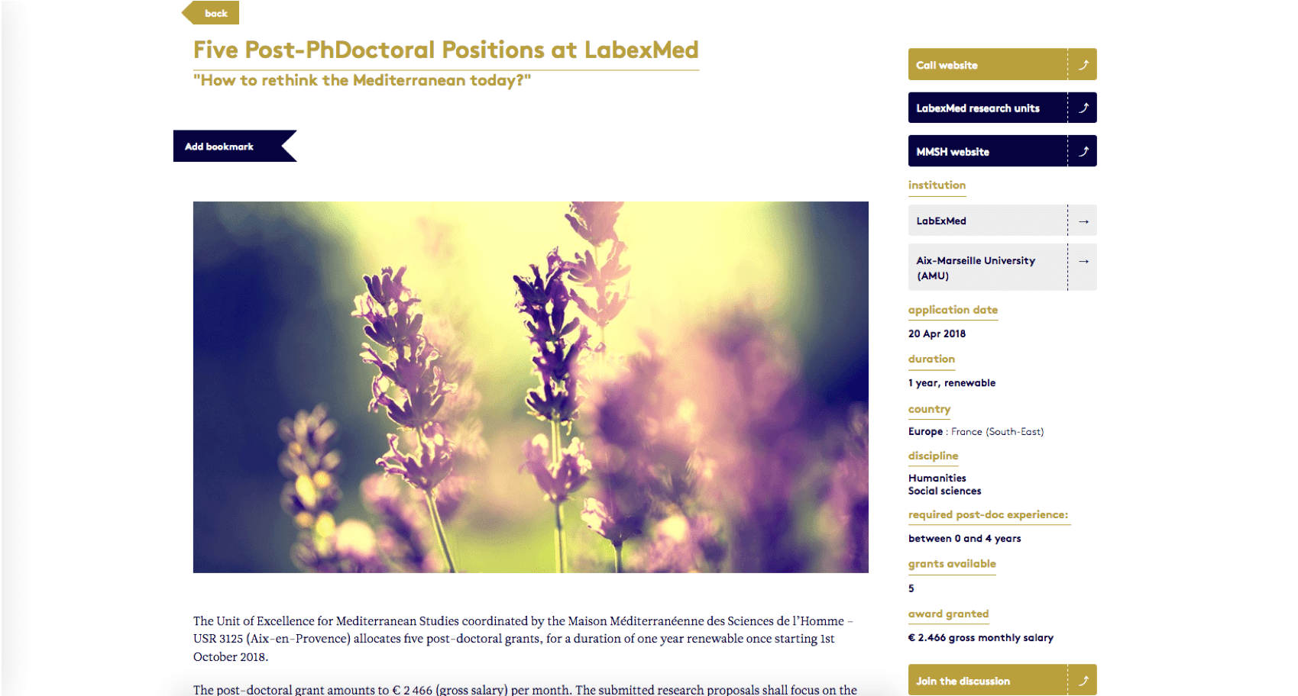

Slide 31
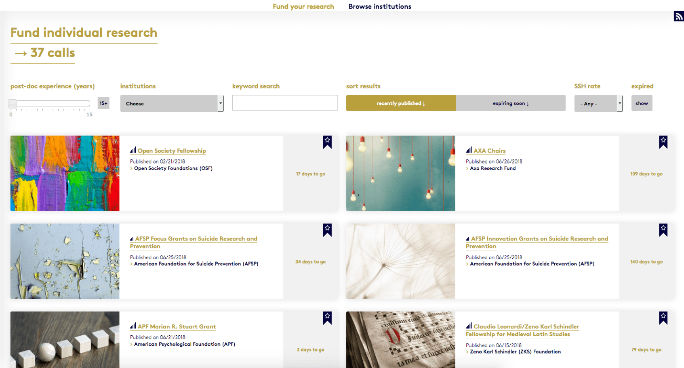

Slide 32
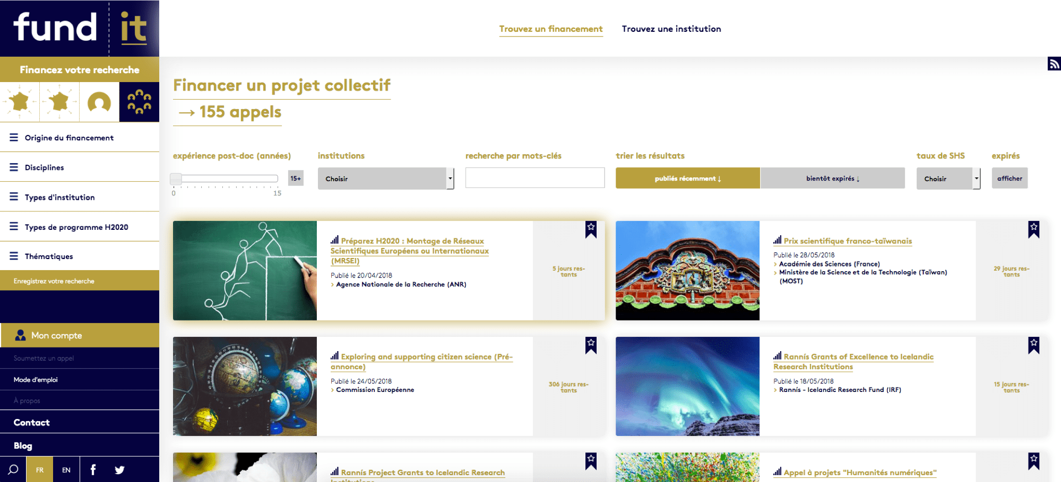
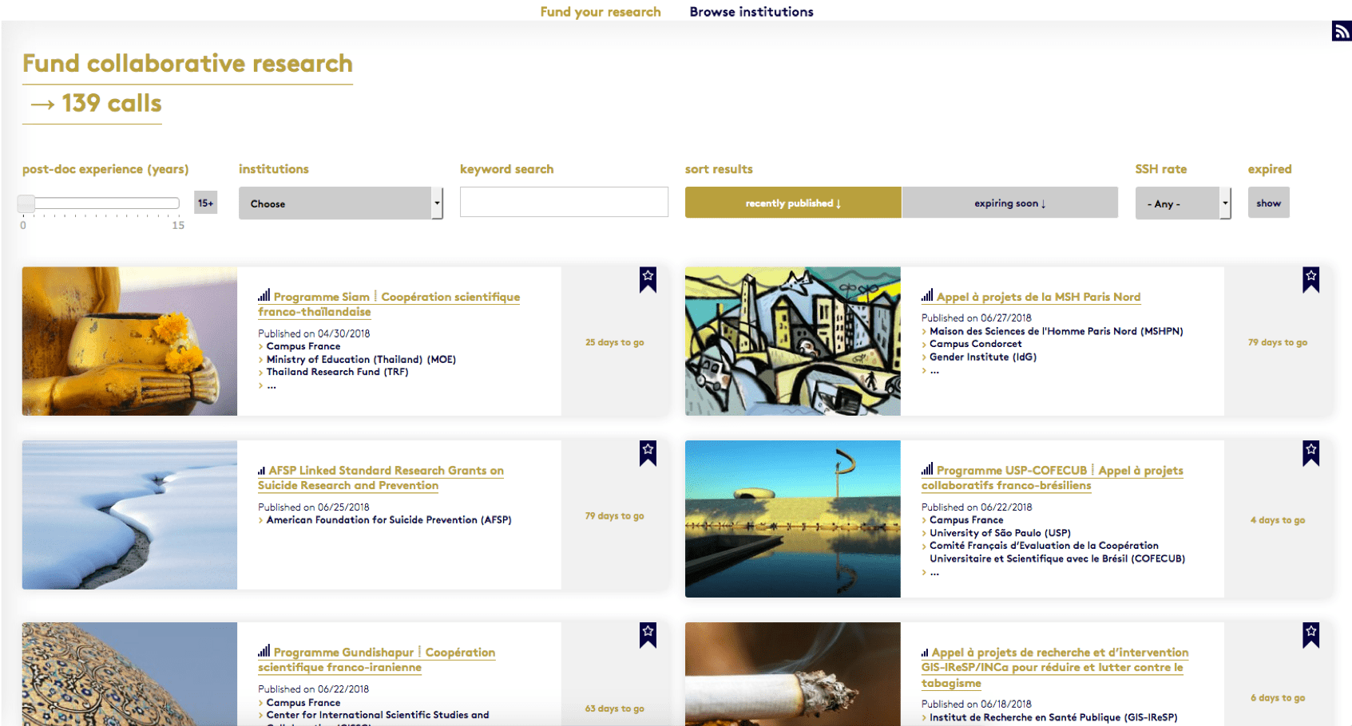

Slide 33
Notes:
LabEx

Slide 34
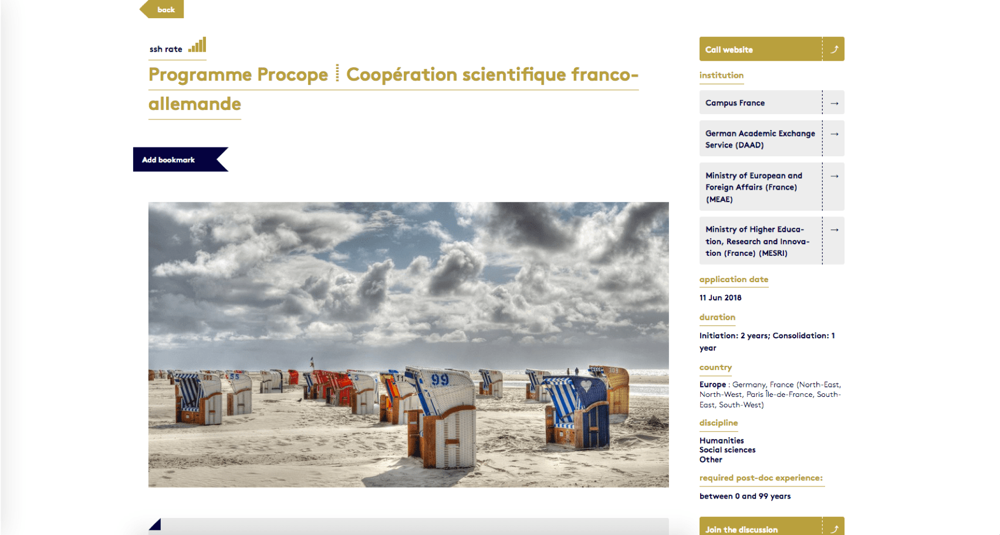
Notes:
LabEx

Slide 35
Notes:
LabEx

Slide 37
Since January 2016…
┋ 1.300 institutions and 1.900 programs in our database;
┋ around 4.000 calls for projects published;
┋ over 3.300 signed up users and over 2.000 followers on social media
fund┋it is funded by the French Ministry for Higher Education, Research and Innovation (MESRI) and RFIEA foundation, with support from CNRS and in partnership with FMSH.
That means it’s free and will remain so.

Slide 38
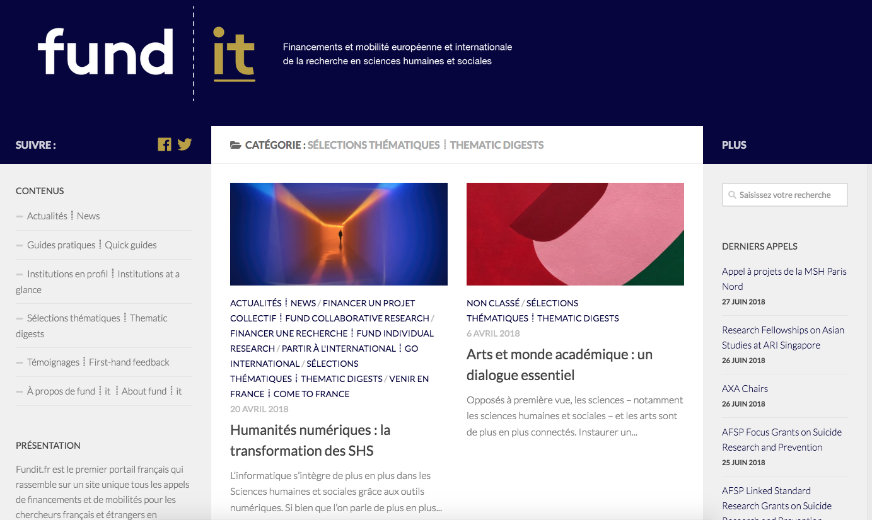
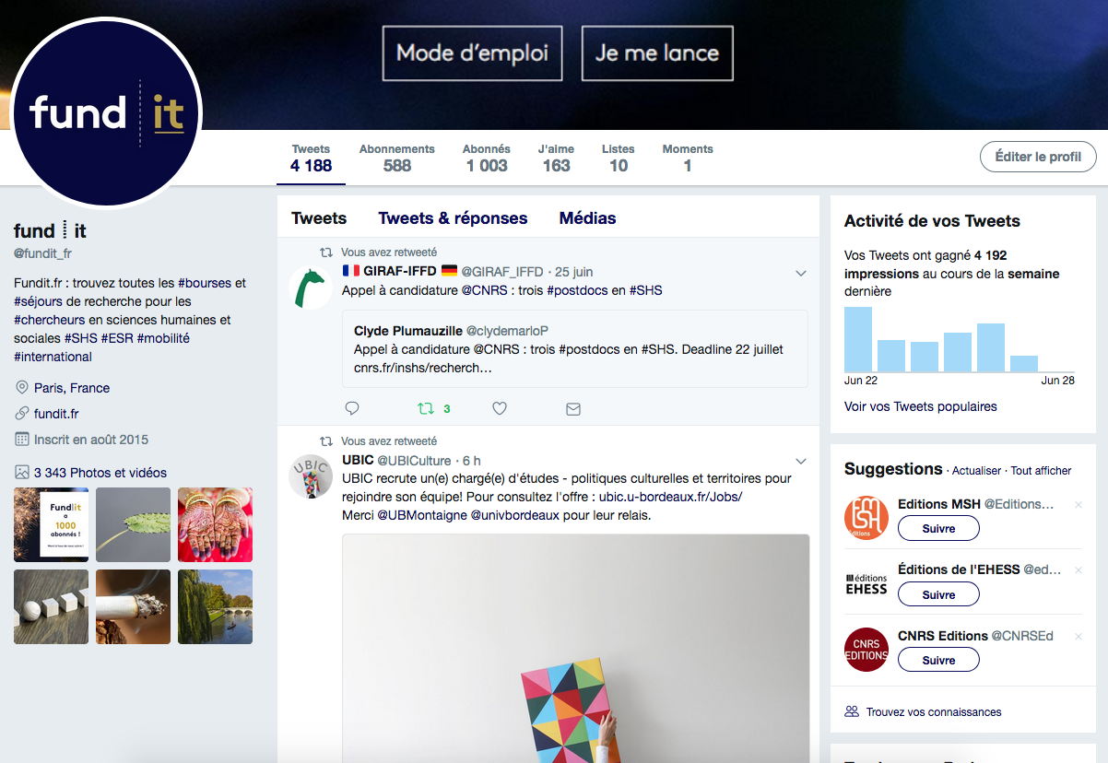
Why fund it via fundit?
┋ Centralized and quality-checked information
┋ Customized e-mail notifications (bookmarks)
┋ Further information and networking (social media, blog)

